Slide 1
Module -1
Part-2
Style sheets: Introduction CSS, Applying CSS to HTML, Selectors, Properties and Values, CSS Colors and Backgrounds, CSS Box Model, CSS Margins, Padding, and Borders, CSS Text and Font Properties

Slide 2
Cascading Style Sheets(CSS)
Introduction to Cascading Style Sheets
Inline Styles
Style Sheets
Selectors
Grouping & Short Hand Properties
Classes
Link
Cascading Styles
Dynamic Style.
Document object model

Slide 3
Cascading Style Sheets (CSS)
CSS are a way to control the look and feel of your HTML documents in an organized and efficient manner.
CSS defines HOW HTML elements are to be displayed.
Development of large web sites, where fonts and color information were added to every single page, became a long and expensive process.
To solve this problem, the World Wide Web Consortium (W3C) created CSS.
In HTML 4.0, all formatting could be removed from the HTML document, and stored in a separate CSS file.
Styles are normally saved in external .css files. External style sheets enable you to change the appearance and layout of all the pages in a Web site, just by editing one single file!

Slide 4
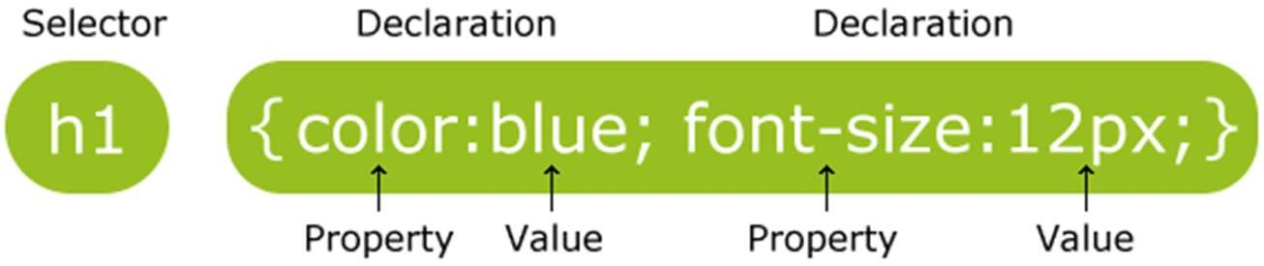
CSS Parts
A CSS rule has two main parts: a selector, and one or more declarations:
The selector is normally the HTML element you want to style.
Each declaration consists of a property and a value.
The property is the style attribute you want to change. Each property has a value.
A CSS declaration always ends with a semicolon, and declaration groups are surrounded by curly brackets.

Slide 5
Comments
Comments are ignored by browsers.
/*This is a comment*/ p
{
text-align:center;
/*This is another comment*/ color:black;
font-family:arial;
}

Slide 6
CSS Demo
<html>
<head>
<style type="text/css"> body
{ background-color:#d0e4fe; } h1
{ color:orange;
text-align:center; }
p
{ font-family:"Times New Roman"; font-size:20px; }
</style> </head>
<body>
<h1>CSS example!</h1>
<p>This is a paragraph.</p>
</body>
</html>

Slide 7
Three Ways to Insert CSS
External style sheet
Internal style sheet
Inline style

Slide 8
External Style Sheet
An external style sheet is ideal when the style is applied to many pages. With an external style sheet, you can change the look of an entire Web site by changing one file. Each page must link to the style sheet using the <link> tag.
<head>
<link rel="stylesheet" type="text/css" href="mystyle.css" />
</head>
An external style sheet can be written in any text editor. The file should not contain any html tags.Your style sheet should be saved with a .css extension.
hr{color:sienna;}
p {margin-left:20px;}
body {background-image:url("images/back40.gif");}
Note: Do not leave spaces between the property value and the units! "margin- left:20 px"

Slide 9
Internal Style Sheet
An internal style sheet should be used when a single document has a unique style.You define internal styles in the head section of an HTML page, by using the <style> tag, like this:
<head>
<style type="text/css"> hr {color:red;}
p {margin-left:20px;}
body {background- image:url("images/back40.gif");}
</style>
</head>

Slide 10
Inline Styles
An inline style loses many of the advantages of style sheets by mixing content with presentation.
To use inline styles you use the style attribute in the relevant tag. The style attribute can contain any CSS property.
<p style="color:red;margin-left:20px">This is a paragraph.</p>

Slide 11
Multiple Style Sheets
If some properties have been set for the same selector in different style sheets, the values will be inherited from the more specific style sheet.
For example, properties for the h3 selector:
External style sheet
Internal style sheet
internal style sheet also links to the external style sheet as final:
color:red;
text-align:right; font-size:20pt;
h3
{
color:red; text-align:left; font-size:8pt;
}
h3
{
text-align:right; font-size:20pt;
}

Slide 12
Cascading Order
Browser default
External style sheet
Internal style sheet (in the head section)
Inline style (inside an HTML element)
So, an inline style (inside an HTML element) has the highest priority, which means that it will override a style defined inside the <head> tag, or in an external style sheet, or in a browser (a default value).
Note: If the link to the external style sheet is placed after the internal style sheet in HTML <head>, the external style sheet will override the internal style sheet!
12

Slide 13
@charset CSS Rule
The @charset rule specifies the character encoding used in the style sheet.
The @charset rule must be the first element in the style sheet and not be preceded by any character. If several @charset rules are defined, only the first one is used.The @charset rule cannot be used inside a style attribute (on an HTML element), or inside the
<style> element where the character set of the HTML page is relevant.
<style>
@charset "UTF-8";</style>
Set the encoding of the style sheet to Unicode UTF-8:

Slide 14
Import stylesheet-@import rule
The @import rule allows you to import a style sheet into another style sheet.
The @import rule must be at the top of the document (but after any @charset declaration).
CSS rule→@import url|string list-of-mediaqueries;
<style>
@import url('styles.css');
</style>

Slide 15
CSS Selectors
CSS selectors are used to "find" (or select) the HTML elements you want to style.
We can divide CSS selectors into five categories:
Simple selectors (select elements based on name, id, class)
Element Selector,Id Selector,Class Selector,Universal Selector,Group Selector
Combinator selectors (select elements based on a specific relationship between them)
Pseudo-class selectors (select elements based on a certain state)
Pseudo-elements selectors (select and style a part of an element)
Attribute selectors (select elements based on an attribute or attribute value)

Slide 16
Element Selector
<!DOCTYPE html>
<html>
<head>
<style> p{
text-align: center; color: blue;
}
</style>
</head>
<body>
<p>This style will be applied on every paragraph.</p>
<p id="para1">Me too!</p>
<p>And me!</p>
</body>
</html>

Slide 17
The id Selector
The id selector is used to specify a style for a single, unique element.
<html>
<head>
<style type="text/css"> #para1
{ text-align:center;
color:red; } #para2
{ text-align:right;
color:blue; }
</style> </head>
<body>
<p id="para1">Hello World!</p>
<p>This paragraph is not affected by the style.</p>
<p id="para2">The id selector uses the id attribute of the HTML element, and is defined with a "#".The style rule below will be applied to the element with id="para2" </p>
</body>
</html>

Slide 18
The class Selector
<html>
<head>
<style type="text/css">
.redcenter
{ text-align:center; color:red; }
</style></head>
<body>
<h1 class="redcenter">Center- aligned heading</h1>
<p class="redcenter">Center- aligned paragraph.</p>
</body></html>
It is used to specify a style for a group of elements.
It uses the HTML class attribute, and is defined with a ".“
Eg: .center {text- align:center;}
You can also specify that only specific HTML elements should be affected by a class.
Eg: p.center {text- align:center;}

Slide 19
Universal Selector
The universal selector is used as a wildcard character (*). It selects all the elements on the pages.
<style>
* {
color: green; font-size: 20px;
}
</style>
</head>
<body>
<h2>This is heading</h2>
<p>This style will be applied on every paragraph.</p>
<p id="para1">Me too!</p>
<p>And me!</p>
</body>
19

Slide 20
Grouping Selectors
The grouping selector is used to select all the elements with the same style definitions.
To minimize the code, you can group selectors.
Separate each selector with a comma.
h1
{
color:green;
}
h2
{
color:green;
}
p
{
color:green;
}
h1,h2,p
{
color:green;
}
p, #idname, .classname {
border-bottom:1px dotted orange;
}
20

Slide 21
Nesting Selectors
It is possible to apply a style for a selector within a selector.
p → style is specified for all p elements
{
color:blue;
text-align:center;
}
.marked → style is specified for all elements with class="marked"
{
background-color:red;
}
.marked p → style is specified only for p elements within elements with class="marked"
{
color:white;
}
21

Slide 22
<html> <head>
<style type="text/css"> p
<body>
<p>This is a blue, center-aligned paragraph.</p>
<div class="marked">
<h1> Heading 1 </h1>
<p>This p element should not be blue.</p>
</div>
<p>p elements inside a "marked" classed element keeps the alignment style, but has a different text color.</p>
</body>
</html>
{
color:blue;
text-align:center; }
.marked
{ background-color:red;
}
.marked p
{
color:white;
}
</style> </head>

Slide 23
CSS - Background Properties
CSS background properties are used to define the background effects of an element.
CSS properties used for background effects:
background-color
background-image
background-repeat
background-attachment
background-position

Slide 24
background-color
body {background-color:#b0c4de;}
p {background-color:#e0ffff;}
div {background-color:#b0c4de;}
h4 { background-color: white; }
ul { background-color: rgb( 149, 206, 145); }
h1 { background-color: rgb( 149, 206, 145, 0.2); }
24

Slide 25
background-image
By default, the image is repeated so it covers the entire element body {background-image:url(“paper.gif ”);}
You can have a background image repeat vertically (y-axis), horizontally (x-axis), in both directions, or in neither direction.
p { background-image: url(“smallPic.jpg”); background-repeat: repeat; }
h4 { background-image: url(“../smallPic.jpg”); background-repeat: repeat-y;}
ol { background-image: url(“../image/smallPic.jpg”); background-repeat: repeat-x;}
ul { background-image: url(“c:/IWP/image/smallPic.jpg”);
background-repeat: no-repeat;}

Slide 26
Background-attachment
You may choose to have your background scroll naturally, or to have it in a fixed position.
body {
background-image: url(smallPic.jpg); background-attachment: fixed; }
body {
background-image: url(smallPic.jpg); background-attachment: scroll;}

Slide 27
background-position
If you would like to define where exactly an image appears within an HTML element, you may use CSS's background-position.
Three different ways of defining position:
length, percentages, and keywords.
p { background-image: url(smallPic.jpg); background-position: 20px 10px; }
h4 { background-image: url(smallPic.jpg); background-position: 30% 30%; }
ol { background-image: url(smallPic.jpg); background-position: top center; }
The location of the image will be (A)px from the left of the screen and (B)px from the top of the screen.
27

Slide 28
Background - Shorthand property
To shorten the code, it is also possible to specify all the properties in one single property.This is called a shorthand property.
body {background:#ffffff url(“img_tree.png”) no-repeat right top;}
When using the shorthand property the order of the property values are:
background-color
background-image
background-repeat
background-attachment
background-position
It does not matter if one of the property values is missing, as long as the ones that are present are in this order.

Slide 29
CSS – Text Properties
Text Color
The color property is used to set the color of the text. body{color:blue;}
h1{color:#00ff00;}
h2 {color:rgb(255,0,0);}
Text Alignment
The text-align property is used to set the horizontal alignment of a text.
Text can be centered, or aligned to the left or right, or justified.
When text-align is set to "justify", each line is stretched so that every line has equal width, and the left and right margins are straight (like in magazines and newspapers).
h1 {text-align:center;} p.main {text-align:justify;}

Slide 30
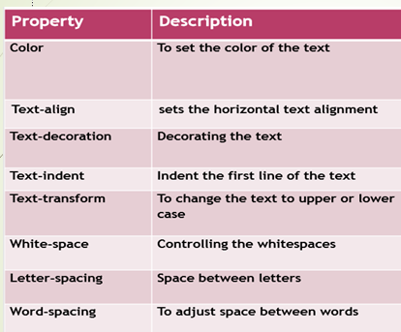

Slide 31
Text Decoration
The text-decoration property is used to set or remove decorations from text.
h1 {text-decoration:overline;}
h2 {text-decoration:line-through;} h3 {text-decoration:underline;} h4 {text-decoration:blink;}
a {text-decoration:none;} → remove underlines from links
Note: The "blink" value is not supported in IE, Chrome, or Safari.
30

Slide 32
Text Transformation
It can be used to turn everything into uppercase or lowercase letters, or capitalize the first letter of each word.
p {text-transform:uppercase;} → lowercase or capitalize
Text Indentation
It is used to specify the indentation of the first line of a text. p {text-indent:50px;}
Word Spacing
It is used to specify the exact value of the spacing between your words. p { word-spacing: 10px; }
Letter Spacing
It is used to specify the exact value of the spacing between your letters. p { letter-spacing: 3px; }

Slide 33
Line Height
The line-height property is used to specify the space between lines: p {line-height:1.8}
Text direction
The direction property is used to change the text direction of an element:
p {direction:rtl;} or ltr

Slide 34
//Text property Example
<html>
<head>
<title> How to use style in text </title>
</head>
<body>
<p style="color:red;"> This text will be written in red. </p>
<p style="direction:rtl;"> This text will be renedered from right to left </p>
<p style="letter-spacing:5px;"> This text is having space between letters. </p>
<p style="word-spacing:5px;"> This text is having space between words.</p>
<p style="text-indent:5cm;"> This text will have first line indented by 5cm and this line will remain at its actual position
this is done by CSS text-indent property.</p>

Slide 35
<p style="text-align:right;">This will be right aligned. </p>
<p style="text-align:center;">This will be center aligned. </p>
<p style="text-align:left;">This will be left aligned.</p>
<p style="text-decoration:underline;">This will be underlined</p>
This will be striked through. </p>
<p style="text-decoration:overline;"> This will have over line</p>
<p style="text-transform:capitalize;"> This will be capitalized</p>
<p style="text-transform:uppercase">This will be in ppercase</p>
<p style="text-transform:lowercase"> This will be in lowercase</p>
<h1 style="text-shadow: red 3px 2px ;">
If your browser supports the CSS text-shadow property,
this text will have a red shadow.</h1>
</body>
</html>

Slide 36
Font Properties
Order must be: style, variant weight, size, line height,font family(s)
p{font:font-style font-variant font-weight font-size font-family}
Font Family
If the name of a font family is more than one word, it must be in quotation marks, like font-family: "Times New Roman".
More than one font family is specified in a comma-separated list:
p{font-family:"Times New Roman“;}
Font Style
This property has three values:
normal - The text is shown normally
italic - The text is shown in italics
oblique - The text is "leaning" (oblique is very similar to italic, but less supported)
p{font-style:normal;}

Slide 37
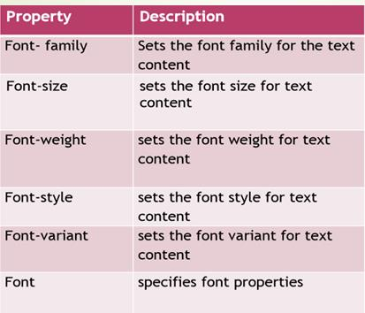

Slide 38
Font Size - sets the size of the text. p {font-size:14px;}
p {font-size:0.875em;} /* 14px/16=0.875em */ p { font-size: 20%; }
The default text size in browsers is 16px. So, the default size of 1em is 16px.
Font Color
h4 { color: red; }
Font Weight
If you want to control the weight of your font (its thickness), using font weight is the best way to go about it.
You only use font-weight in multiples of 100 (e.g. 200, 300, etc) .The values range from 100 (thin)-900 (thick).
p { font-weight: 100; } ul{ font-weight: bolder; }
Available key terms for font-weight: bold or bolder, lighter and normal.
Font Variant - allows you to convert your font to all small caps to upper case with small size font.
p { font-variant: small-caps; }
34
p { font-variant: normal; }

Slide 39
//Font Property - Example
<html>
<head>
<title> How to use font style </title>
</head>
<body>
<p style="font-family:Times New Roman, arial, calibari;">
This text is rendered in either Times New Roman, arial, calibri, or the default
serif font depending on which font you have at your system.
</p>
<p style="font-style:oblique;">
Font style of this para is oblique </p>
<p style="font-variant:small-caps;">
This text will be rendered as small caps
</p>

Slide 40
<p style="font-weight:bold;">
This font is bold.
</p>
<p style="font-weight:900">
This font is 900 weight.
</p>
<p style="font-size:xx-large;">
This font size is xx-large
</p>
<p style="font-size:small;">
This font size is small
</p>
<p style="font-size:large;">
This font size is large
</p>
</body></html>

Slide 41
List Properties
PropertyDescription
list-style-image → Specifies an image as the list-item marker
list-style-position → Specifies if the list-item markers should appear inside or outside the content flow
list-style-type → Specifies the type of list-item marker
list-style → Sets all the properties for a list in one declaration
list-style: list-style-type | list-style-position | list-style-image
37

Slide 42
<html> <head>
<style type="text/css"> ul.a {list-style-type:circle;} ul.b {list-style-type:disc;} ul.c {list-style-type:square;} ol.f {list-style-type:decimal;}
ol.g {list-style-type:decimal-leading- zero;}
ol.n {list-style-type:lower-alpha;} ol.q {list-style-type:lower-roman;} ol.r {list-style-type:upper-alpha;}
ol.t {list-style-type:upper-roman;} ol.u {list-style-type:none;}
ol.v {list-style-image: url("purple.gif");}
</style> </head>
<body>
<ul class="a">
<li>Circle type</li> </ul>
<ul class="b">
<li>Disc type</li> </ul>

Slide 43
<ol class="r">
<li>Upper-alpha type</li>
</ol>
<ol class="t">
<li>Upper-roman type</li>
</ol>
<ol class="u">
<li>None type</li>
</ol>
<ol class="v">
<li>Image type</li>
</ol>
</body> </html>
<ul class="c">
<li>Square type</li></ul>
<ol class="f">
<li>Decimal type</li></ol>
<ol class="g">
<li>Decimal-leading-zero type</li>
</ol>
<ol class="n">
<li>Lower-alpha type</li> </ol>
<ol class="q">
<li>Lower-roman type</li>
</ol>

Slide 44
Link Properties
The four links states are:
a:link - a normal, unvisited link
a:visited - a link the user has visited
a:hover - a link when the user mouse over it
a:active - a link the moment it is clicked
a:link {color:#FF0000;} /* unvisited link */ a:visited {color:#00FF00;} /* visited link */ a:hover {color:#FF00FF;} /* mouse over link */ a:active {color:#0000FF;} /* selected link */
When setting the style for several link states, there are some order rules:
a:hover MUST come after a:link and a:visited
a:active MUST come after a:hover

Slide 45
<html> <head>
<style type="text/css"> a.one:link {color:#ff0000;} a.one:visited {color:#0000ff;} a.one:hover {color:#ffcc00;} a.two:link {color:#ff0000;} a.two:visited {color:#0000ff;} a.two:hover {font-size:150%;} a.three:link {color:#ff0000;} a.three:visited {color:#0000ff;}
a.three:hover {background:#66ff66;} a.four:link {color:#ff0000;} a.four:visited {color:#0000ff;} a.four:hover {font-family:monospace;} a.five:link { color:#ff0000;
text-decoration:none;}
a.five:visited {color:#0000ff; text-decoration:none;}
a.five:hover{text-decoration:underline;} a.six:link,a.six:visited
{ display:block; font-weight:bold; color:#FFFFFF;
background-color:#98bf21; width:120px;
text-align:center; padding:4px;
text-decoration:none;} a.six:hover,a.six:active
{ background-color:#7A991A; text-decoration:underline;}
</style> </head>

Slide 46
<body>
<p>Mouse over the links to see them change layout.</p>
<p><b><a class="one" href="default.asp" target="_blank">This link changes color</a></b></p>
<p><b><a class="two" href="default.asp" target="_blank">This link changes font-size</a></b></p>
<p><b><a class="three" href="default.asp" target="_blank">This link changes background-color</a></b></p>
<p><b><a class="four" href="default.asp" target="_blank">This link changes font-family</a></b></p>
<p><b><a class="five" href="default.asp" target="_blank">This link changes text-decoration</a></b></p>
<p><b><a class="six" href="../tutorial.html" target="_blank">This link changes Box Color</a></b></p>
</body></html>

Slide 47
Table Properties
Table Borders table, th, td
{
border: 1px solid red;
}
Notice that the table in the example above has double borders.This is because both the table and the th/td elements have separate borders.
To display a single border for the table, use the border- collapse property.

Slide 48
Collapse Borders
Table Width and Height
Width and height of a table is defined by the width and height properties.
table
{
width:100%;
}
th
{
height:50px;
}
The border-collapse property sets whether the table borders are collapse into a single border or separated or intial:
border-collapse: separate|collapse|initial
table
{
border-collapse:collapse;
}
table, td, th
{
border:1px solid red;
}

Slide 49
Table Text Alignment
The text in a table is aligned with the text-align and vertical-align properties.
The text-align property sets the horizontal alignment, like left, right, or center
td{
text-align:right;
}
The vertical-align property sets the vertical alignment, like top, bottom, or middle:
td{
height:50px; vertical-align:bottom;
}

Slide 50
Table Padding
To control the space between the border and content in a table, use the padding property on td and th elements:
td
{
padding:15px;
}
Table Color
The example below specifies the color of the borders, and the text and background color of the elements:
table, td, th
{
border:1px solid green;
}
th
{
background-color:green; color:white;
}

Slide 51
Table border-spacing
The distance between the borders of adjacent cells: border-spacing: length|initial table.ex1 {
border-collapse: separate; border-spacing: 10px;} table.ex2 {
border-collapse: separate; border-spacing: 10px 50px;
}
Table caption-side
The caption-side property specifies the placement of a table caption.
caption-side: top|bottom|initial
table, td, th
{
border:1px solid green;
}
th
{
background-color:green; color:white;
}

Slide 52
Table empy-cells
Sets whether or not to display borders and background on empty cells in a table
empty-cells: show|hide|initial
table {
border-collapse: separate; empty-cells: hide;
}

Slide 53
BOX MODEL
In CSS, the term "box model" is used when talking about design and layout. It is essentially a box that wraps around HTML elements.
Margin - Clears an area around the border. The margin does not have a background color, it is completely transparent.
Border - A border that goes around the padding and content. The border is affected by the background color of the box.
Padding - Clears an area around the content. The padding is affected by the background color of the box.
Content -The content of the box, where text and images appear

Slide 54


Slide 55
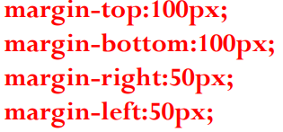
The margin clears an area around an element (outside the border).
The margin does not have a background color, and is completely transparent.
The top, right, bottom, and left margin can be changed
independently using separate properties.
A shorthand margin property can also be used, to change all margins at once.

Slide 56
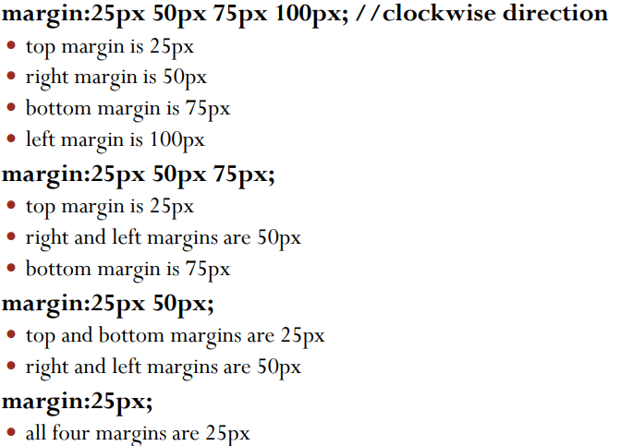
Margin – Short hand property

Slide 57
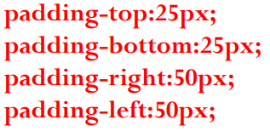
Padding
The padding clears an area around the content (inside the border) of an element. The padding is affected by the background color of the element.
The top, right, bottom, and left padding can be changedindependently using separate properties.
A shorthand padding property can also be used, to change allpaddings at once.

Slide 58
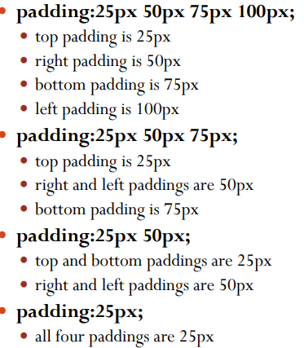
Padding short hand property

Slide 59
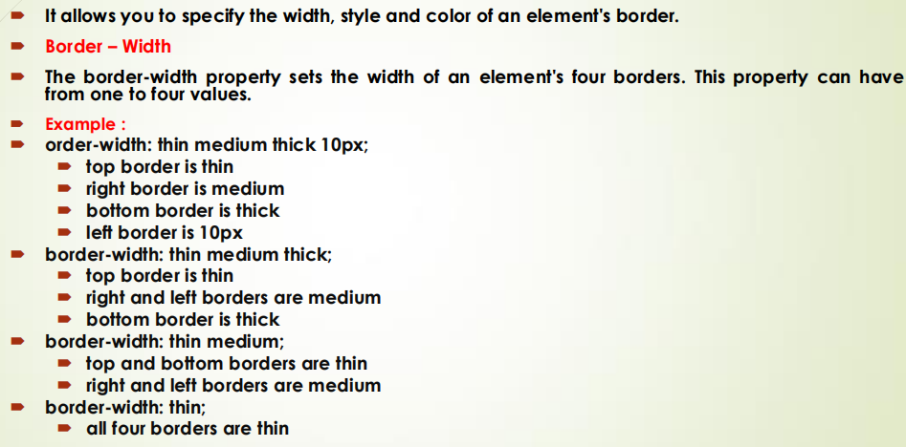
Border Property

Slide 60
The border-style property specifies what kind of border to display.
The following values are allowed:
dotted - Defines a dotted border
dashed - Defines a dashed border
solid - Defines a solid border
double - Defines a double border
groove - Defines a 3D grooved border. The effect depends on the border-color value
ridge - Defines a 3D ridged border. The effect depends on the border-color value
inset - Defines a 3D inset border. The effect depends on the border-color value
outset - Defines a 3D outset border. The effect depends on the border-color value
none - Defines no border
hidden - Defines a hidden border

Slide 61
<!DOCTYPE html>
<html>
<head>
<title>CSS Border Styles</title>
<style>
div {
width: 250px;
padding: 10px;
margin: 10px;
border-width: 5px;
border-color: black;
}
.none { border-style: none; }
.hidden { border-style: hidden; }
.dotted { border-style: dotted; }
.dashed { border-style: dashed; }
.solid { border-style: solid; }
.double { border-style: double; }
.groove { border-style: groove; }
.ridge { border-style: ridge; }
.inset { border-style: inset; }
.outset { border-style: outset; }
</style></head><body>
<h2>CSS Border Style Property</h2>
<div class="none">border-style: none</div>
<div class="hidden">border-style: hidden</div>
<div class="dotted">border-style: dotted</div>
<div class="dashed">border-style: dashed</div>
<div class="solid">border-style: solid</div>
<div class="double">border-style: double</div>
<div class="groove">border-style: groove</div>
<div class="ridge">border-style: ridge</div>
<div class="inset">border-style: inset</div>
<div class="outset">border-style: outset</div>
</body>
</html>

Slide 62
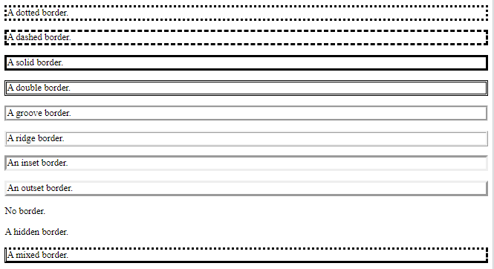
Border Style Property

Slide 63
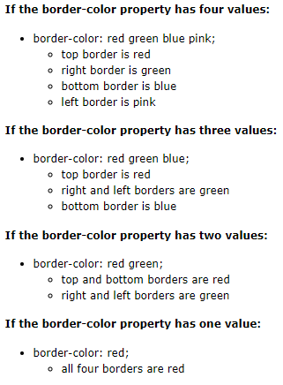
Border Color Property
The border-color property sets the color of an element's four borders. This property can have from one to four values

Slide 64
Margin
The margin clears an area around an element (outside the border). The margin does not have a background color, and is completely transparent.
The top, right, bottom, and left margin can be changed independently using separate properties. A shorthand margin property can also be used, to change all margins at once.
margin-top:100px;
margin-bottom:100px;
margin-right:50px;
margin-left:50px;
margin:25px 50px 75px 100px;
top margin is 25px
right margin is 50px
bottom margin is 75px
left margin is 100px

Slide 65
CSS Combinator Selector
A CSS selector can contain more than one simple selector. Between the simple selectors, can include a combinator.
There are four different combinators in CSS:
descendant selector (space)
child selector (>)
adjacent sibling selector (+)
general sibling selector (~)

Slide 66
Descendant and Child selector
Descendant Selector (space)→matches all elements that are descendants of a specified element.<p> elements inside
<div> elements:
div p { background-color: yellow; }
Child Selector(>)→The child selector selects all elements that are the children of a specified element.
div > p {
background-color: yellow;
}

Slide 67
Adjacent Sibling Selector (+) and General Sibling Selector (~)
Aadjacent sibling selector(+) →used to select an element that is directly after another specific element. Sibling elements must have the same parent element, and "adjacent" means "immediately following".
div + p { background-color: yellow; }
General sibling selector(~)→ selects all elements that are next siblings of a specified element.
div ~ p {
background-color: yellow;
}

Slide 68
<!DOCTYPE html>
<html>
<head>
<title>CSS Combinator Selectors</title>
<style>
/* 1. Descendant Selector (space) */
div p {
color: blue;
}
/* 2. Child Selector (>) */
div > h3 {
color: green;
}
/* 3. Adjacent Sibling Selector (+) */
h2 + p {
color: red;
}
/* 4. General Sibling Selector (~) */
h4 ~ p {
color: purple;
}
</style>
</head>
<body>
<h2>CSS Combinator Selector Example</h2>
<div>
<h3>Child Heading (div > h3)</h3>
<p>Paragraph inside div (descendant selector)</p>
<section>
<p>Nested paragraph inside section (descendant selector)</p>
</section>
</div>
<h2>Adjacent Sibling</h2>
<p>This paragraph is immediately after h2</p>
<p>This paragraph is NOT affected</p>
<h4>General Sibling</h4>
<p>Paragraph 1 after h4</p>
<p>Paragraph 2 after h4</p>
</body>
</html>

Slide 69
What are Pseudo-classes?
A pseudo-class is used to define a special state of an element.
For example, it can be used to:
Style an element when a user mouse over it
Style visited and unvisited links differently
Style an element when it gets focus
The syntax of pseudo-classes:
selector:pseudo-class { property: value; }

Slide 70
CSS - The :first-child Pseudo-class
The :first-child pseudo-class matches a specified element that is the first child of another element.
p:first-child { color: blue; }
Match the first <i> element in all <p> elements
the selector matches the first <i> element in all <p> elements: p i:first-child { color: blue; }
Match all <i> elements in all first child <p> elements
p:first-child i { color: blue; }
57

Slide 71
The :nth-child(n) selector matches every element that is the nth child of its parent. n can be a number, a keyword (odd or even), or a formula
(like an + b). a represents a cycle size, n is a counter (starts at 0), and b is an offset value.
/* Selects the second element of div siblings */ div:nth-child(2) {
background: red;
}
/* Selects the second li element in a list */ li:nth-child(2) {
background: lightgreen;
}
/* Selects every third element among any group of siblings */
:nth-child(3) { background: yellow;
}

Slide 72
nth-child(an+b)
Using a formula (an + b). Description: a represents a cycle size, n is a counter (starts at 0), and b is an offset value.
Here, we specify a background color for all p elements whose index is a multiple of 3 (will select the third, sixth, ninth, etc):
p:nth-child(3n+0) { background: red;
}

Slide 73
The :nth-last-child(n) selector matches every element that is the nth child, regardless of type, of its parent, counting from the last child. n can be a number, a keyword, or a formula.
a background color for every <p> element that is the second child of its parent, counting from the last child:
p:nth-last-child(2) { background: red;}
:nth-last-of-type(n) selector matches every element that is
the nth child, of a particular type, of its parent, counting from the last child.n can be a number, a keyword, or a formula.
a background color for every <p> element that is the second p element of its parent, counting from the last child:
p:nth-last-of-type(2) { background: red;
}
60

Slide 74
CSS3 Attribute Selectors
Style HTML Elements With Specific Attributes
It is possible to style HTML elements that have specific attributes or attribute values.
CSS [attribute] Selector
The [attribute] selector is used to select elements with a specified attribute.
Example: selects all <a> elements with a target attribute:
a[target] { background-color: yellow; }
CSS [attribute="value"] Selector
The [attribute="value"] selector is used to select elements with a specified attribute and value.
for example: selects all <a> elements with a target="_blank" attribute:
a[target="_blank"] { background-color: yellow; }
61

Slide 75
CSS3 Attribute Selectors
CSS [attribute~="value"] Selector
The [attribute~="value"] selector is used to select elements with an attribute value containing a specified word.
[title~="flower"] { border: 5px solid yellow;
}

Slide 76
What are Pseudo-Elements?
A CSS pseudo-element is used to style specified parts of an element.
For example, it can be used to:
Style the first letter, or line, of an element
Insert content before, or after, the content of an element
The syntax of pseudo-elements:
selector::pseudo-element { property: value; }

Slide 77
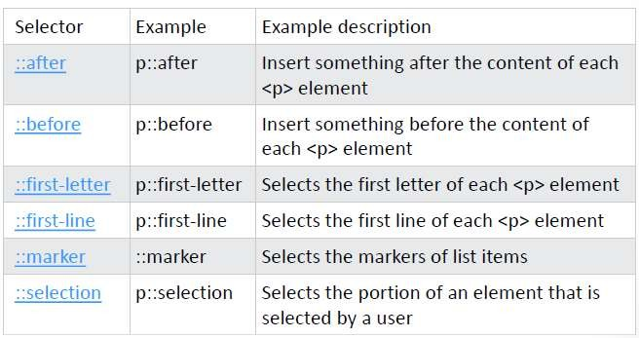
All CSS Pseudo Elements

Slide 78
The :first-line Pseudo-element
The "first-line" pseudo-element is used to add special styles to the first line of the text in a selector:
p {font-size: 12pt}
p::first-line {color: #0000FF; font-variant: small-caps}
<p>Some text that ends up on two or more lines</p>
The output could be something like this:
SOME TEXT THAT ENDS up on two or more lines

Slide 79
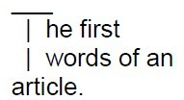
The :first-letter Pseudo-element
The "first-letter" pseudo-element is used to add special style to the first letter of the text in a selector:
p {font-size: 12pt}
p::first-letter {font-size: 200%; float: left}
<p>The first words of an article.</p>
The output could be something like this:

Slide 80

CSS - The ::before Pseudo-element
The ::before pseudo-element can be used to insert some content before the content of an element.
The following example inserts an image before the content of each <h1> element:
h1::before {
content: url(smiley.gif);
}

Slide 81

CSS - The ::after Pseudo-element
The ::after pseudo-element can be used to insert some content after the content of an element.
The following example inserts an image after the content of each <h1> element:
h1::after {
content: url(smiley.gif);
}

Slide 82
<span>
span> is an inline element and it can be used to group inline-elements in an HTML document.
<span> tag is used with inline elements where as the <div> tag is used with block-level elements.
<!DOCTYPE html>
<html>
<body>
<p>My mother has <span style="color:blue;font-weight:bold">blue</span> eyes and my father has <span style="color:darkolivegreen;font-weight:bold">dark green</span> eyes.</p>
</body>
</html>
71

Slide 83
Position
The CSS positioning properties allow you to position an element.
It can also place an element behind another, and specify what should happen when an element's content is too big.
Elements can be positioned using the top, bottom, left, and right properties. However, these properties will not work unless the position property is set first.They also work differently depending on the positioning method.
There are four different positioning methods.
static(default)
fixed
relative
absolute
Sticky
86

Slide 84
Static Positioning
HTML elements are positioned static by default. A static positioned element is always positioned according to the normal flow of the page.
Static positioned elements are not affected by the top, bottom, left, and right properties.
87

Slide 85
Fixed Positioning
An element with fixed position is positioned relative to the browser window.
It will not move even if the window is scrolled:
p.pos_fixed
{
position:fixed; top:30px; right:5px;
}
Note: IE7 and IE8 support the fixed value only if a !DOCTYPE is specified.
Fixed positioned elements are removed from the normal flow.The document and other elements behave like the fixed positioned element does not exist.
Fixed positioned elements can overlap other elements.

Slide 86
Relative Positioning
A relative positioned element is positioned relative to its normal position.
h2.pos_left
{
position:relative; left:-20px;
}
The content of relatively positioned elements can be moved and overlap other elements, but the reserved space for the element is still preserved in the normal flow.
h2.pos_top
{
position:relative; top:-50px;
}
Relatively positioned elements are often used as container blocks for absolutely positioned elements.

Slide 87
Absolute Positioning
An absolute position element is positioned relative to the first parent element that has a position other than static. If no such element is found, the containing block is <html>:
h2
{
position:absolute; left:100px; top:150px;
}
Absolutely positioned elements are removed from the normal flow.The document and other elements behave like the absolutely positioned element does not exist.
Absolutely positioned elements can overlap other elements.
90

Slide 88
Overlapping Elements
When elements are positioned outside the normal flow, they can overlap other elements.
The z-index property specifies the stack order of an element (which element should be placed in front of, or behind, the others).
An element can have a positive or negative stack order: img
{
position:absolute; z-index:-1
}
An element with greater stack order is always in front of an element with a lower stack order.

Slide 89
Navigation Bars
Having easy-to-use navigation is important for any web site.
With CSS you can transform boring HTML menus into good-looking navigation bars.
Navigation Bar = List of Links
A navigation bar needs standard HTML as a base.
In our examples we will build the navigation bar from a standard HTML list.

Slide 90
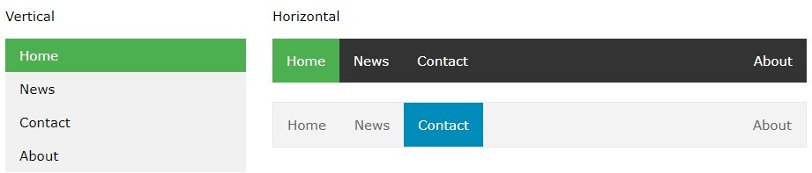
Navigation Bars
body { margin: 0; } ul {
list-style-type: none; margin: 0;
padding: 0;
width: 25%;
background-color: #f1f1f1; position: fixed;
height: 100%; overflow: auto;
}
li a {
display: block; color: #000; padding: 8px 16px;
text-decoration: none;
}
li a.active {
background-color: #4CAF50; color: white;}
li a:hover:not(.active) { background-color: #555; color: white; }
</style></head>
<body>
<ul>
<li><a class="active" href="#home">Home</a></li>
<li><a href="#news">News</a></li>
<li><a href="#contact">Contact</a></li>
<li><a href="#about">About</a></li></ul>

Slide 91
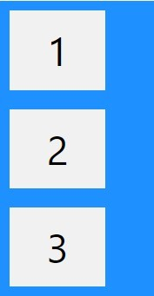
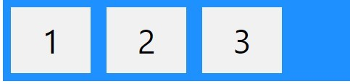
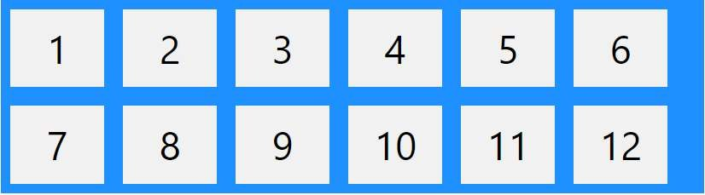
Flexbox
a layout model that offers a variety of ways to arrange the element and helps us align the element in CSS.
we can control the sizing alignment and positioning of elements within a container regardless of the order in HTML.
It introduces flex containers and flex items as its two main parts.
Flex containers→by changing an element's display property to flex or inline-flex.
The container is used as the parent element for the flex items and transforms into a flexible box or flex container.
A flex container's direct child elements are transformed into flex items.

Slide 92
Flex container Properties
flex-direction: with the help of flex-direction, we can arrange the element in any direction →row, column, row-reverse, and column
-reverse.
justify-content:Determines how flex items are aligned horizontally within the container using the justify-content property→center,flex- start,flex-end,space-around,space-between
align-items: Defines the vertical alignment of flex items inside the container→center,flex-start,flex-end,stretch,baseline
flex-wrap: whether or not flex items should wrap across multiple lines or remain on a single line→wrap,nowrap,wrap-reverse
align-content: When the cross-axis has extra space, align-content regulates how the flex lines are aligned→center,flex-start,flex- end,stretch,space-between,space-around
flex-flow→shorthand property for setting both the flex-direction and flex-wrap properties
107

Slide 93
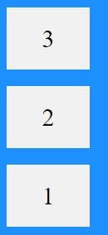

Flex container
<div class="flex-container">
<div>1</div>
<div>2</div>
<div>3</div>
</div>
.flex-container { display: flex;
flex-direction: column/row/column-reverse/row-reverse; background-color: DodgerBlue;
}

Slide 94
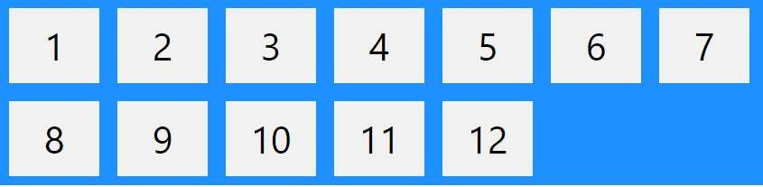
Flex container
<div class="flex-container">
<div>1</div>
<div>2</div>
<div>3</div>
</div>
.flex-container1 { display: flex;
flex-wrap: wrap/nowrap/wrap-reverse; background-color: DodgerBlue;
}

Slide 95


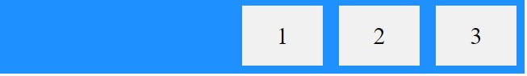

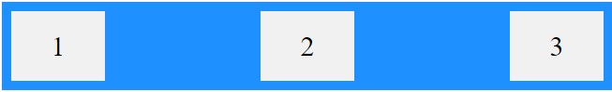
Flex container
<div class="flex-container">
<div>1</div>
<div>2</div>
<div>3</div>
</div>
.flex-container1 { display: flex;
justify-content: center/flex-start/flex-end/space-around/space- between;
background-color: DodgerBlue;
}

Slide 96
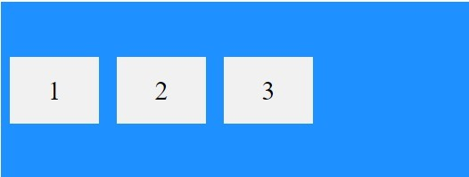
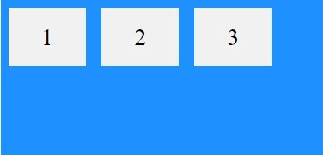
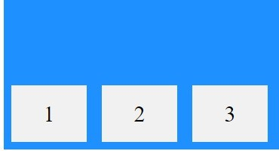
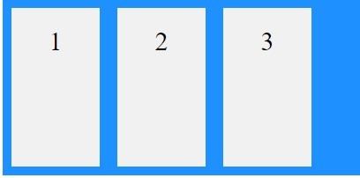
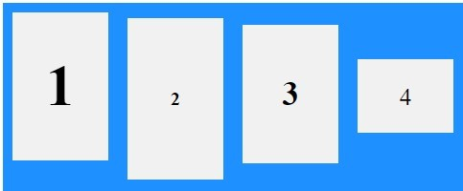
Flex container
<div class="flex-container">
<div>1</div>
<div>2</div>
<div>3</div>
</div>
.flex-container { display: flex; height: 200px;
align-items: center/flex-start/flex-end/stretch/baseline; background-color: DodgerBlue;
}

Slide 97
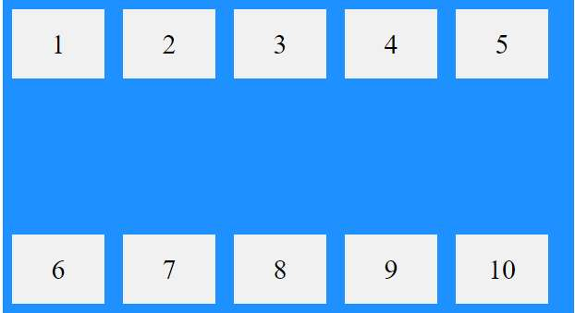
Flex container
<div class="flex-container">
<div>1</div>
<div>2</div>
<div>3</div>
</div>
.flex-container { display: flex; height: 600px; flex-wrap: wrap;
align-content: space-between/space-around/flex-start/flex-
end/stretch/center;
}
112

Slide 98

Flex item CSS properties
The flex item properties are:
Property | Description
align-self | Specifies the alignment for a flex item (overrides the flex container's align-items property)
flex | A shorthand property for the flex-grow, flex-shrink, and the flex- basis properties
flex-basis | Specifies the initial length of a flex item
flex-grow | Specifies how much a flex item will grow relative to the rest of the flex items inside the same container default is 1
flex-shrink | Specifies how much a flex item will shrink relative to the rest of the flex items inside the same container
order | Specifies the order of the flex items inside the same container

Slide 99
Flex items
<div class="flex-container">
<div>1</div>
<div>2</div>
<div style="align-self: center">3</div>
<div>4</div>
<div class="flex-container">
<div>1</div>
<div>2</div>
<div style="flex- basis:200px">3</div>
<div>4</div>
</div>
<div class="flex-container">
<div style="flex-grow: 1">1</div>
<div style="flex-grow: 1">2</div>
<div style="flex-grow: 8">3</div>
<div style="flex-shrink:0">4</div>
</div>
<div class="flex-container">
<div style="order: 3">1</div>
<div style="order: 2">2</div>
<div style="order: 4">3</div>
<div style="order: 1">4</div>
</div>

Slide 100
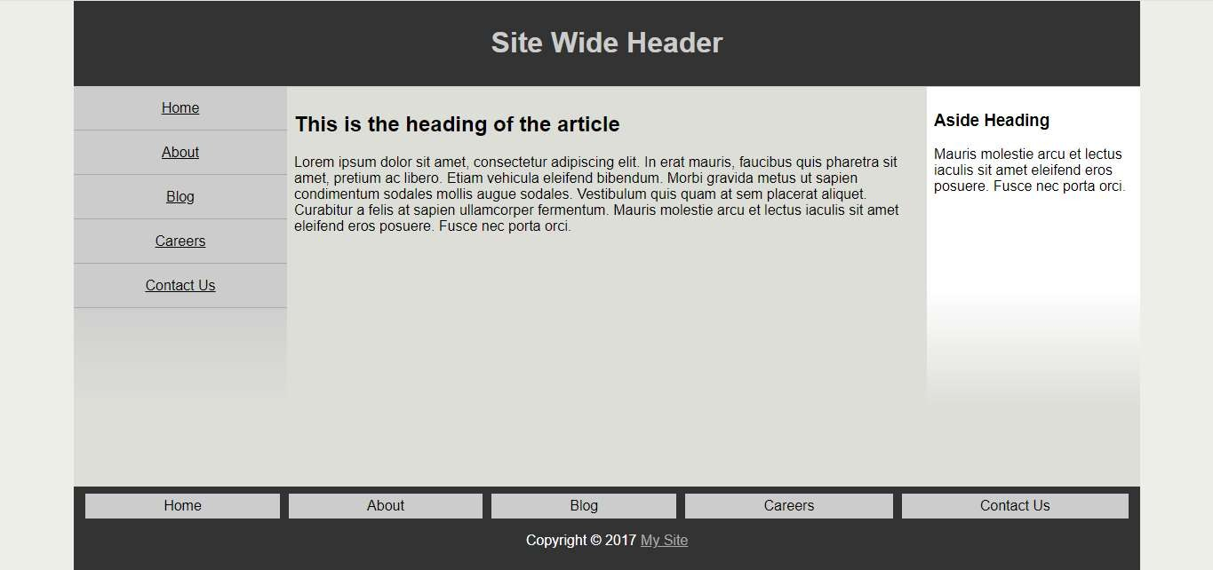

Slide 101
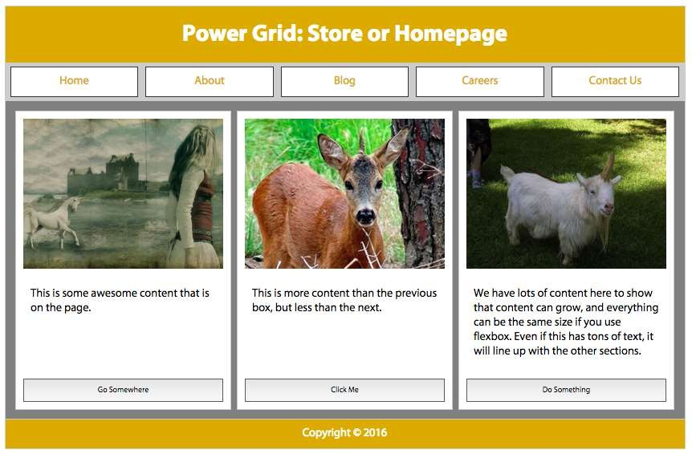

Slide 102
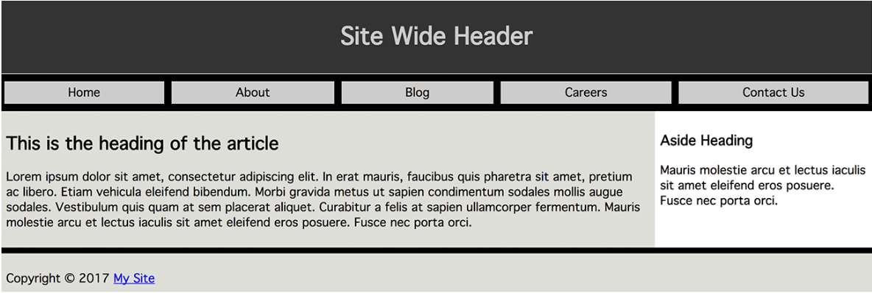

Slide 103
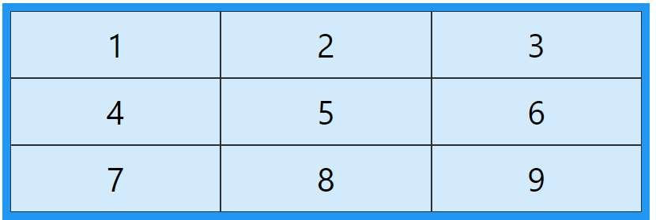
CSS Grid Layout model
offers a grid-based layout system, with rows and columns, making it easier to design web pages without having to use floats and positioning.
Grid Container→it is a parent element that has several child elements, which turn into grid items. We create a new grid formatting context for the children of an element by setting it to be a grid container.
Grid Items→to the grid container's child elements. These are the components that the grid layout has positioned and aligned. Multiple rows and columns of grid items are possible, allowing for adaptable and dynamic arrangements.

Slide 104
CSS Grid Layout model
Adjust the gap size by using one of the following properties:
column-gap→ column gap in px
row-gap→ row gap in px
gap →The gap property is a shorthand property for the row-gap and the column-gap properties
Grid Lines
The lines between columns are called column lines.
The lines between rows are called row lines.
grid-column-start, grid-column-end
grid-row-start, grid-row-end

Slide 105
Grid Container
Grid containers consist of grid items, placed inside columns and rows.
grid-template-columns→the number of columns in your grid layout, and it can define the width of each column.
grid-template-rows →the number of rows in your grid layout, and it can define the height of each column.
justify-content and align-content
.grid-container { display: grid;
grid-template-columns: 80px 200px auto 40px;
}
.grid-container { display: grid;
grid-template-rows: 80px 200px;
}
120

Slide 106
Grid Item-Child Element(Items)
a container has one grid item for each column, in each row, but you can style the grid items so they will span multiple columns / rows.
grid-column→on which column(s) to place an item. where the item will start, and where the item will end.
.item1 {
grid-column: 1 / 5;
grid-row→on which row to place an item. So where the item will start, and where the item will end.
.item1 {
grid-row: 1 / 4;
}
121

Slide 107
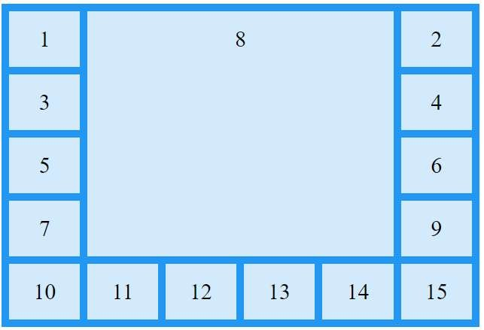
Grid Item- grid-area Property
grid-area→as a shorthand property for the grid-row-start, grid- column-start, grid-row-end and the grid-column-end
.item8 {
grid-area: 1 / 2 / 5 / 6;
}
Item8 will start on row-line 1 and column-line 2, and end on row- line 5 column-line 6

Slide 108
Grid Item- Named Grids
grid-area property→to assign names to grid items. Named grid items can be referred to by the grid-template-areas property
Item1 gets the name "myArea" and spans all five columns in a five columns grid layout:
.item1 {
grid-area: myArea;
}
.grid-container {
grid-template-areas: 'myArea myArea myArea myArea myArea';
}
myArea" span two columns in a five-column grid layout (period signs represent items with no name.
.grid-container {
grid-template-areas: 'myArea myArea . . .';
}

Slide 109
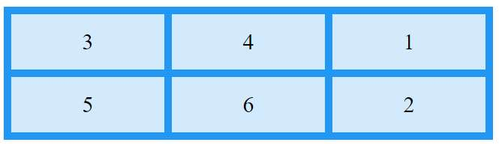
Grid Item- Order of Items
.item1 { grid-area: 1 / 3 / 2 / 4; }
.item2 { grid-area: 2 / 3 / 3 / 4; }
.item3 { grid-area: 1 / 1 / 2 / 2; }
.item4 { grid-area: 1 / 2 / 2 / 3; }
.item5 { grid-area: 2 / 1 / 3 / 2; }
.item6 { grid-area: 2 / 2 / 3 / 3; }
124

Slide 110
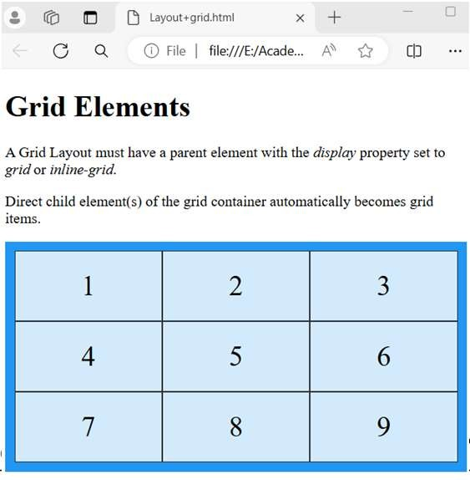
<body>
Layout - Grid
<h1>Grid Elements</h1>
<!DOCTYPE html><html><head><style> <p>A Grid Layout must have a parent
.grid-container { display: grid;
grid-template-columns: auto auto auto; background-color: #2196F3;
padding: 10px;}
.grid-item {
background-color: rgba(255, 255, 255, 0.8);
border: 1px solid rgba(0, 0, 0, 0.8); padding: 20px;
font-size: 30px; text-align: center;}
</style></head>
element with the <em>display</em> property set to <em>grid</em> or
<em>inline-grid</em>.</p>
<p>Direct child element(s) of the grid container automatically becomes grid items.</p>
<div class="grid-container">
<div class="grid-item">1</div>
<div class="grid-item">2</div>
<div class="grid-item">3</div>
<div class="grid-item">4</div>
<div class="grid-item">5</div>
<div class="grid-item">6</div>
<div class="grid-item">7</div>
<div class="grid-item">8</div>
<div class="grid-item">9</div>
</div></body></html>
125

Slide 111
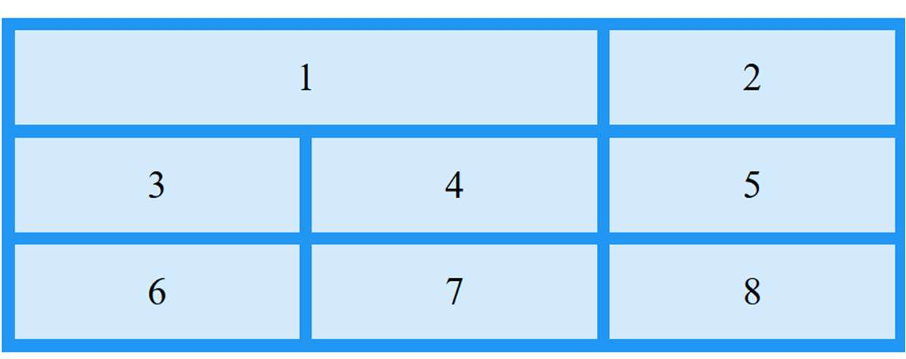
The CSS Grid Layout Module offers a grid-based layout system, with rows and columns, making it easier to design web pages without having to use floats and positioning.
A grid layout consists of a parent element, with one or more child elements.
An HTML element becomes a grid container when its display property is set to grid or inline-grid.
.item1 {
grid-column-start: 1;
grid-column-end: 3;
}
<div class="item1">1</div>
126

Slide 112

127

Slide 113
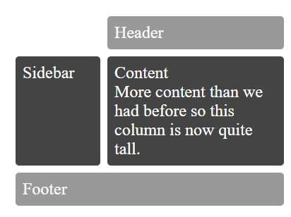

Slide 114
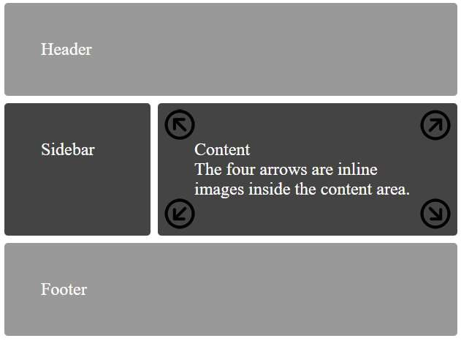

Slide 115
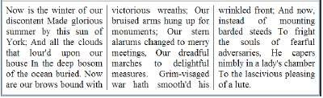
Multi-column layout
It easy definition of multiple columns of text - just like in newspapers
column-count →Specifies the number of columns an element should be divided into
column-fill→Specifies how to fill columns
column-gap→Specifies the gap between the columns
column-rule→A shorthand property for setting all the column-rule-* properties
column-rule-color→Specifies the color of the rule between columns
column-rule-style→Specifies the style of the rule between columns
column-rule-width→Specifies the width of the rule between columns
column-span→Specifies how many columns an element should span across.Values→none|all
column-width→Specifies a suggested, optimal width for the columns
columns→A shorthand property for setting column-width and column- count
130

Slide 116
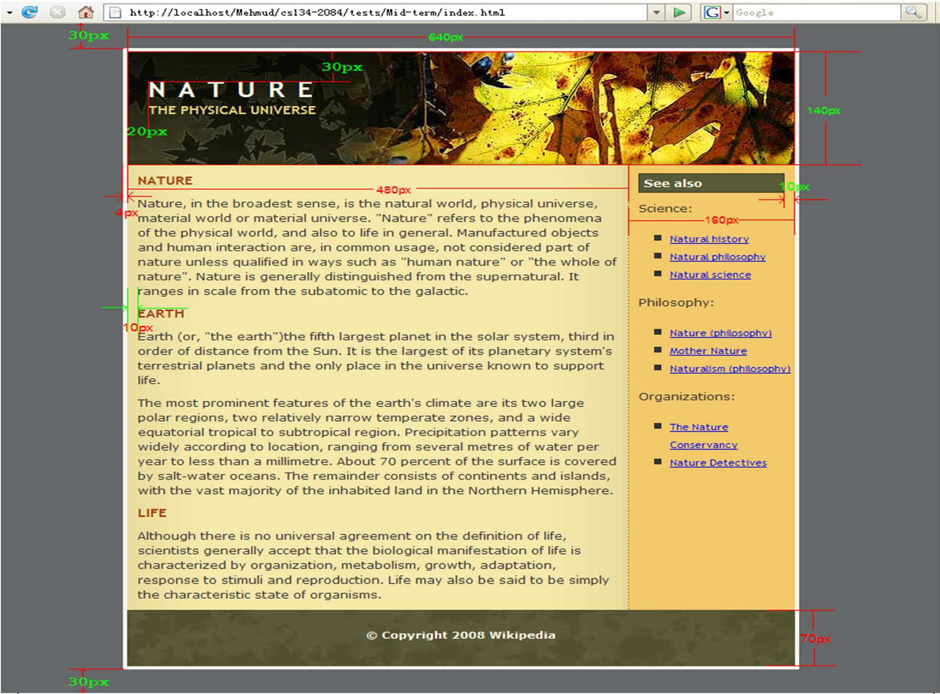
94

Slide 117
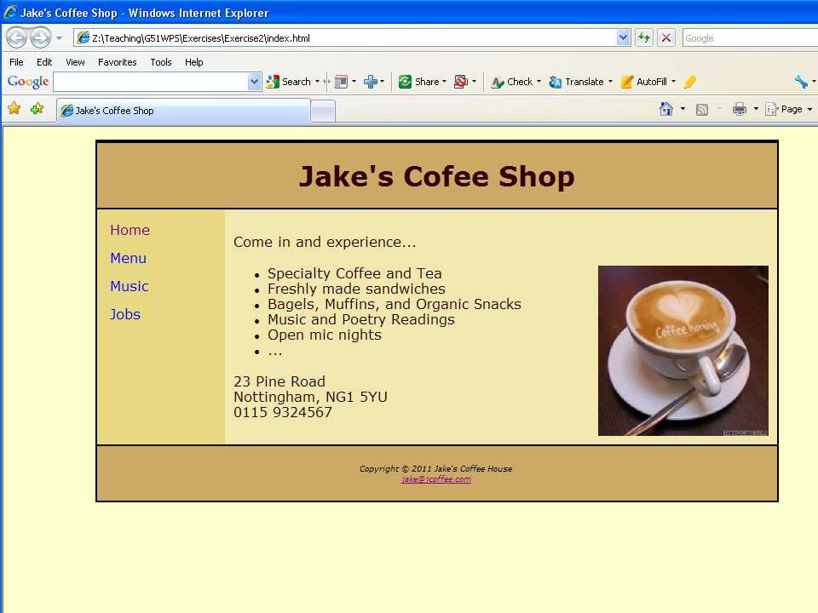

Slide 118
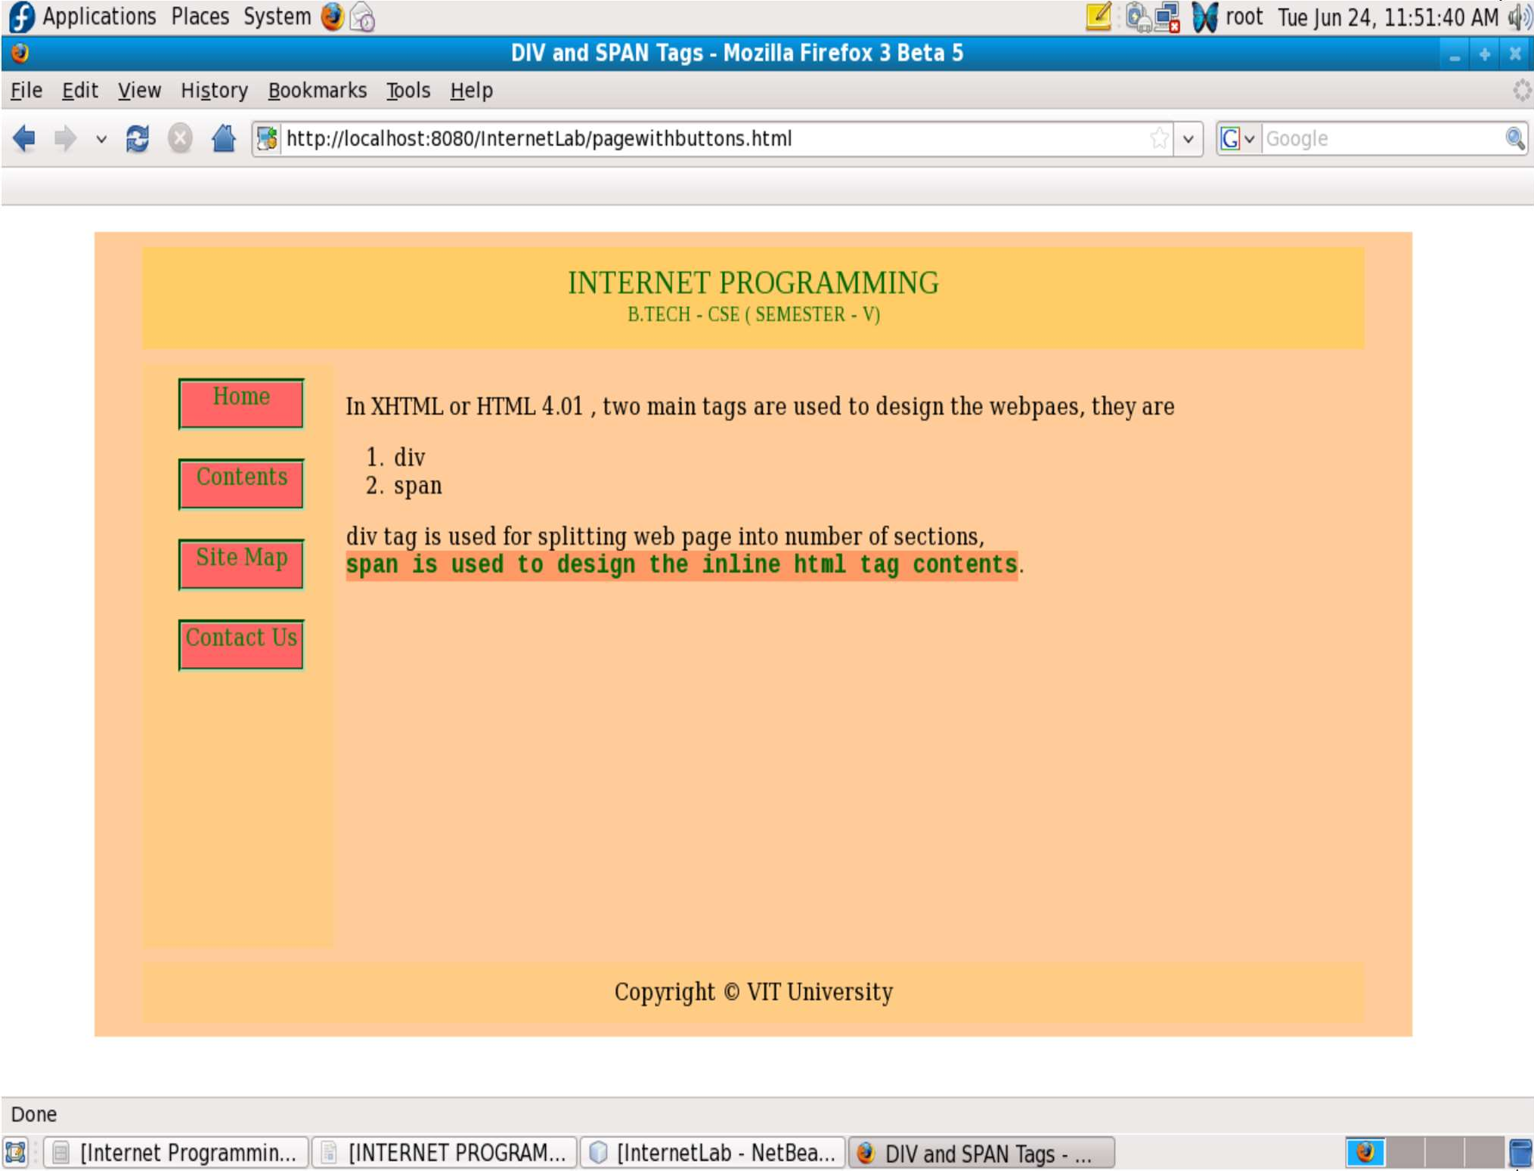
Design web page with Buttons and links Using CSS, DIV, and Span Tags.

Slide 119
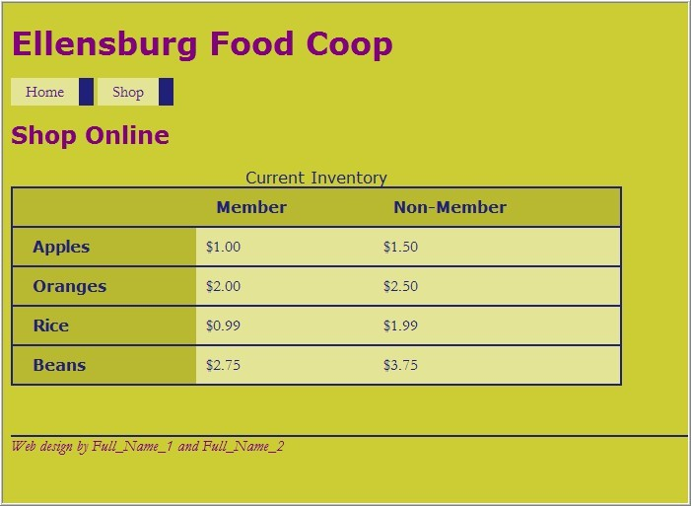
97

